Slide 1
Approximate matching

Slide 2
Contents
What is it used for ?
Coding + trace back
Example explaining the algorithm
Explain the penalty/scoring matrix rules

Slide 3
What is it used for ?
There are many application that used Approximate matching in our life such as:
Plagiarism Detection
Bioinformatics and DNA Sequencing
Spam filters
Search engines or content search in large databases

Slide 4
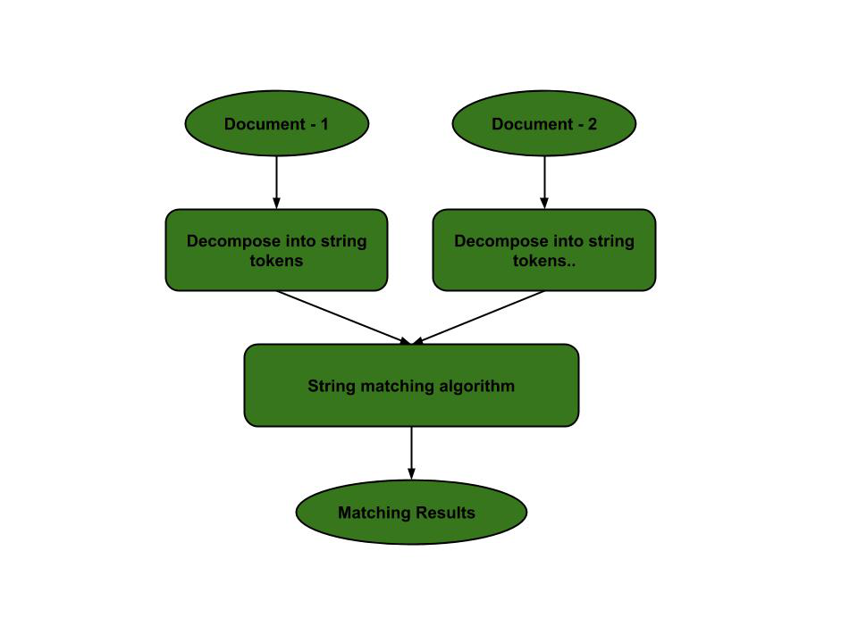
Plagiarism Detection
The documents to be compared are decomposed into string tokens and compared using string matching algorithms. Thus, these algorithms are used to detect similarities between them and declare if the work is plagiarized or original.

Slide 5
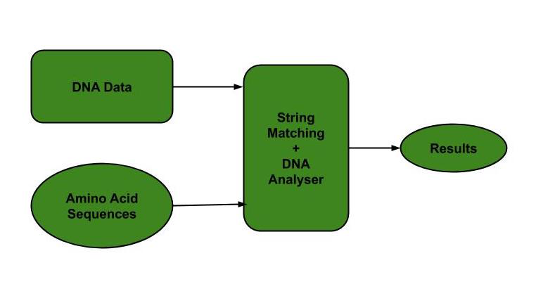
Bioinformatics and DNA Sequencing
Bioinformatics involves applying information technology and computer science to problems involving genetic sequences to find DNA patterns. String matching algorithms and DNA analysis are both collectively used for finding the occurrence of the pattern set.

Slide 6
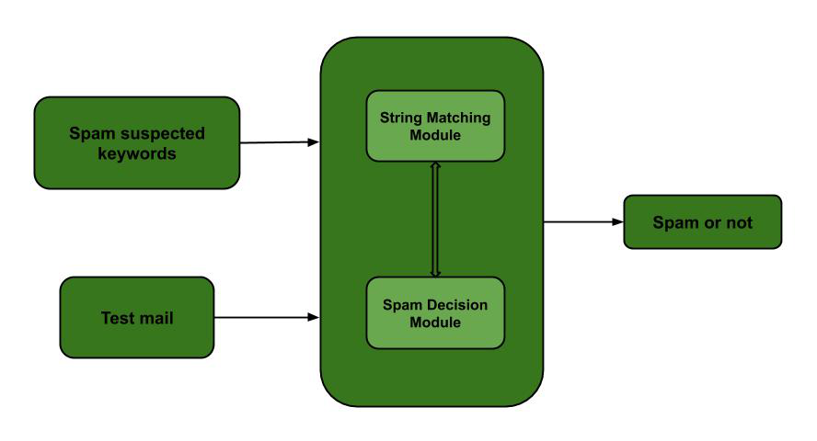
Spam filters
Spam filters use string matching to discard the spam. For example, to categorize an email as spam or not, suspected spam keywords are searched in the content of the email by string matching algorithms. Hence, the content is classified as spam or not.

Slide 7
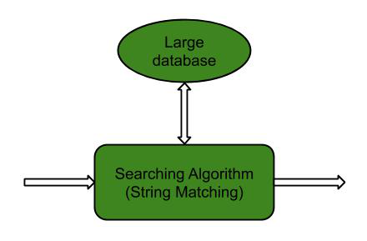
Search engines or content search in large databases
To categorize and organize data efficiently, string matching algorithms are used. Categorization is done based on the search keywords. Thus, string matching algorithms make it easier for one to find the information they are searching for.

Slide 8
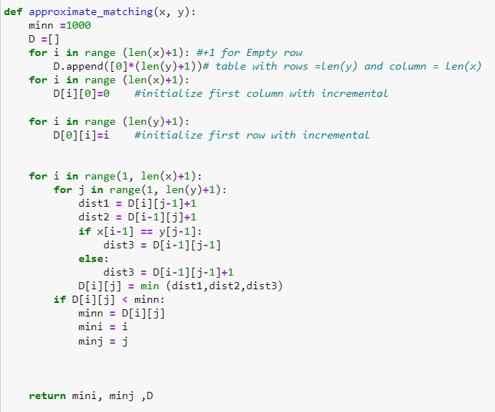
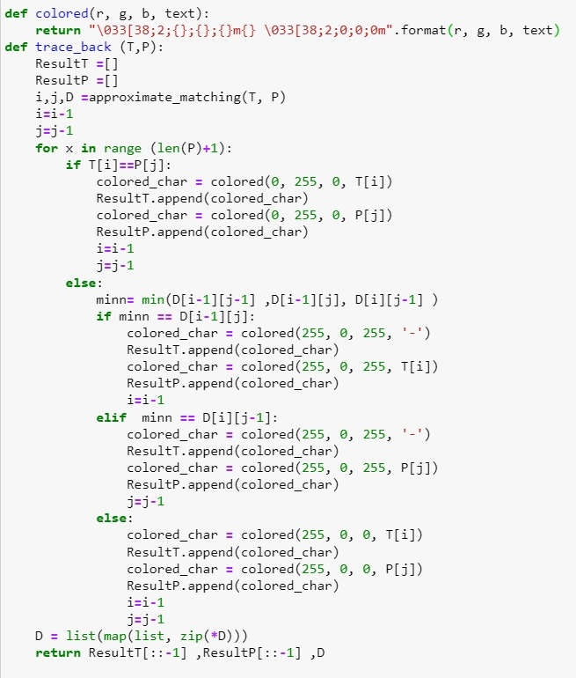
Coding + trace back

Slide 9
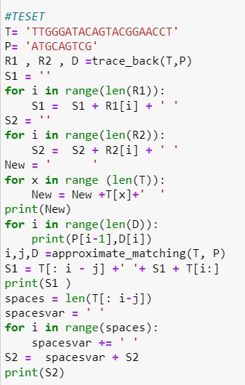
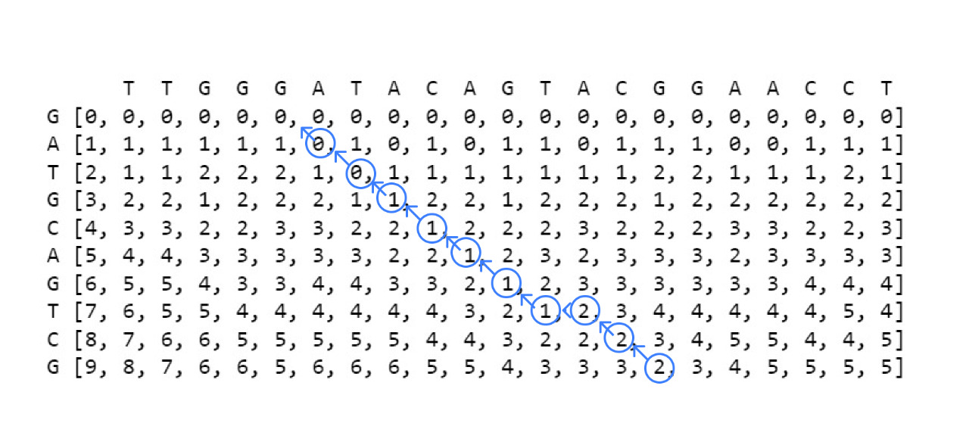
Coding + trace back (cont.)

Slide 10
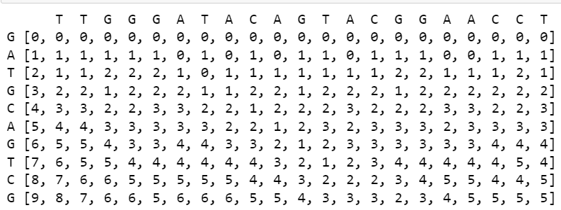
Example explaining the algorithm
Text= ‘ TTGGGATACAGTACGGAACCT ‘
Pattern= 'ATGCAGTCG‘
1- we apply the approximate_matching()
function to create the matrix

Slide 11
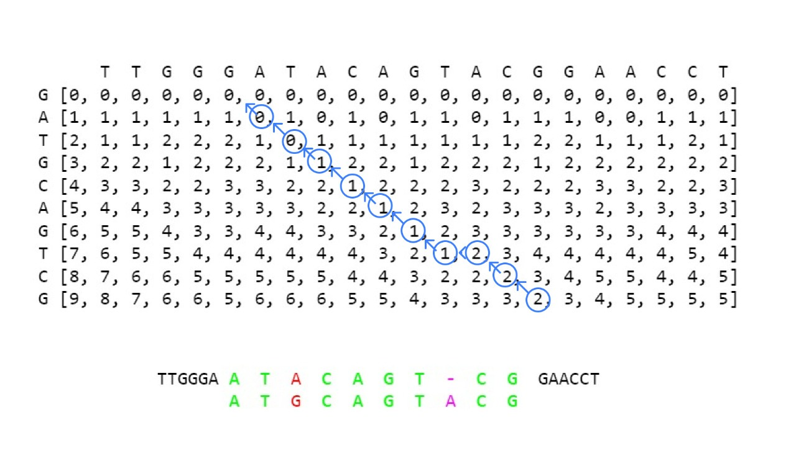
Example explaining the algorithm(cont.)
2- we apply the trace_back( ) function to detect the occurrence of the pattern in the text.
-the red color determine the mismatch.
-the green color determine that characters are matched.
- the pink one determine gap in text or pattern.

Slide 12
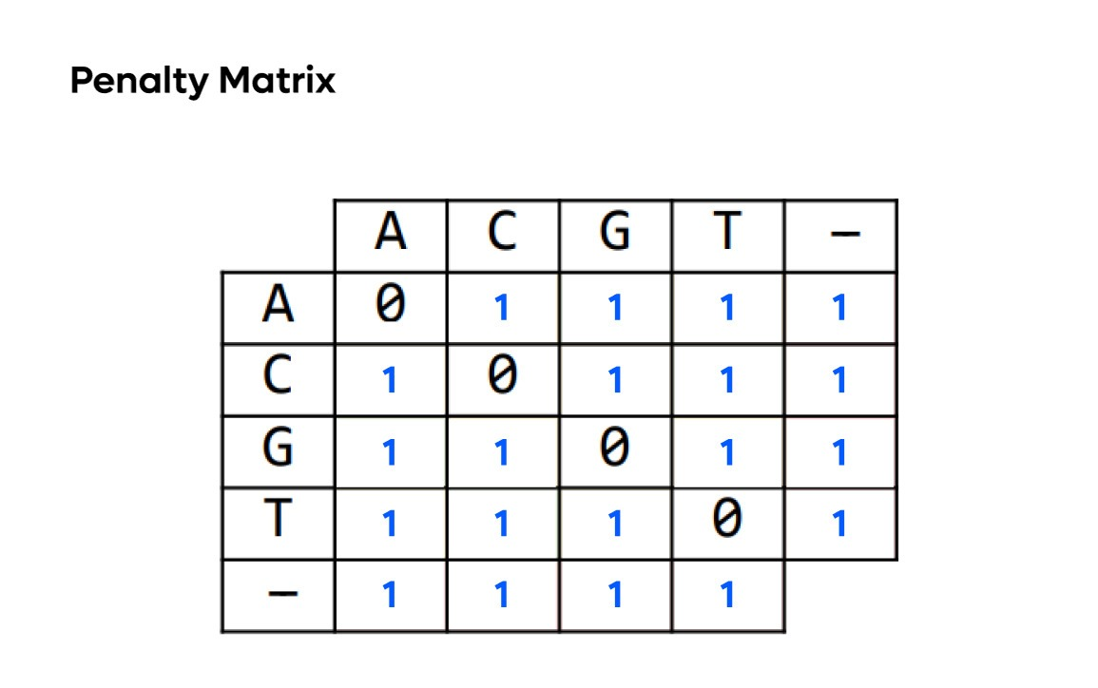
Explain the penalty/scoring matrix rules
In approximate matching the penalty is fixed (+1) for all the mismatches or the gaps.

Slide 13
Thanks ☺

